Slide 1

Analysis of NYC Dessert Businesses 2023
Andrew Cheng

Slide 2
Assumptions
Data was pulled from Yelp’s API on September 2023.
Businesses can have more than one categorical attribute.
Businesses containing at least one of the following were included in the analysis:
bakeries, patisserie, viennoiserie, desserts, cake, donut
Here, I will often refer to review_counts and rating as a metric for foot traffic and success.

Slide 3
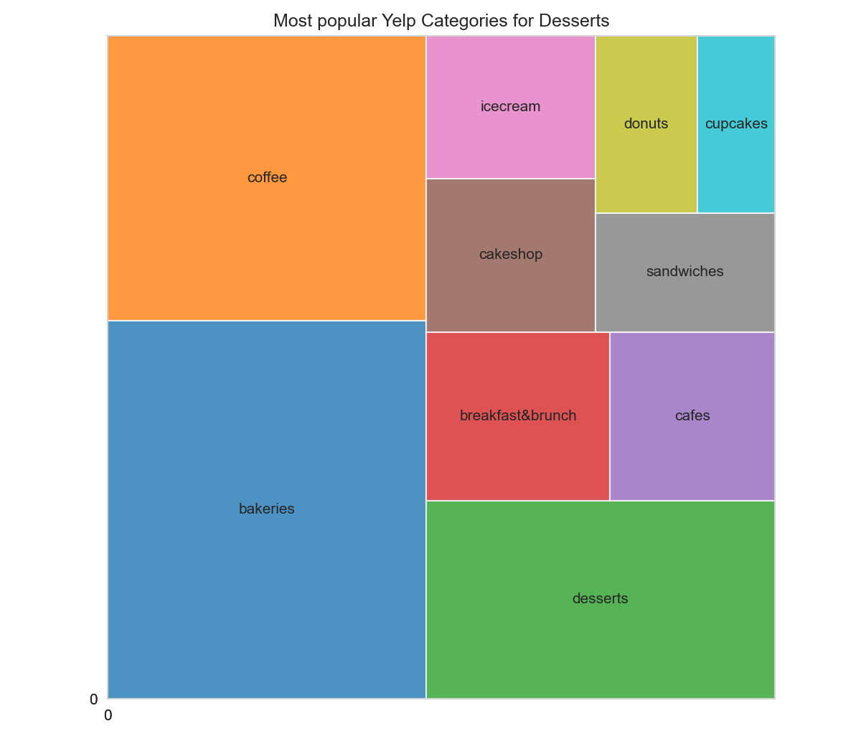
Most Popular Business Types by Count
‘Bakeries’ comprising 27% of this cohort
‘Coffee’ shops comprising 20%
‘Desserts’ comprising about 16%
’Breakfast and Brunch’ comprises about 7%
‘Cafes’ comprising about 6%

Slide 4
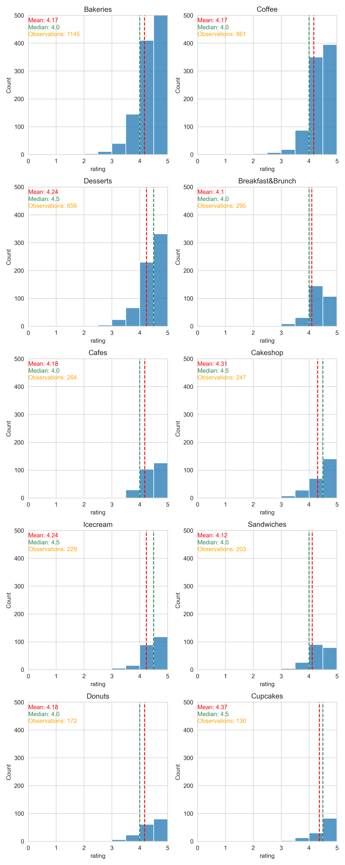
Category | Mean Rating | Median Rating
Bakeries | 4.17 | 4.0
Coffee | 4.17 | 4.0
Desserts | 4.24 | 4.5
BnB | 4.1 | 4.0

Slide 5
Category | Mean Rating | Median Rating
Cafes | 4.18 | 4.0
Cakeshop | 4.31 | 4.5
Ice cream | 4.24 | 4.5
Sandwiches | 4.12 | 4.0

Slide 6
Category | Mean Rating | Median Rating
Donuts | 4.18 | 4.0
Cupcakes | 4.37 | 4.5

Slide 7
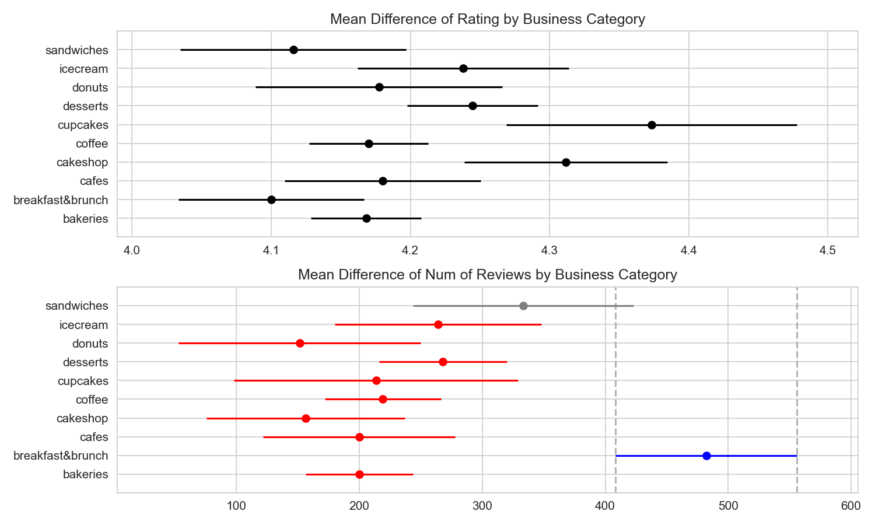
Multiple Comparison of Means (Review Count) ANOVA / Tukeys HSD
No significant (p < 0.05) differences between major dessert categories.
Breakfast and Brunch outperforms all dessert categories.

Slide 8
Multiple Comparison of Means (Rating) ANOVA / Tukeys HSD
Some categories performed better than others
No apparent winners

Slide 9
Multiple Comparison of Means (Rating), continued Statistically Significant Results
Category | Category | Mean difference | p-value
bakeries | cakeshops | 0.140 | 0.0025
bakeries | cupcakes | 0.205 | 0.0006
breakfast&brunch | cakeshop | 0.211 | 0.0001
breakfast&brunch | cupcakes | 0.273 | <0.0001
breakfast&brunch | desserts | 0.145 | 0.0022
cafes | cupcakes | 0.193 | 0.0154
coffee | cakeshop | 0.142 | 0.0049
coffee | cupcakes | 0.203 | 0.0010
donuts | cupcakes | 0.196 | 0.0334
cakeshops and cupcakes generally underperform

Slide 10
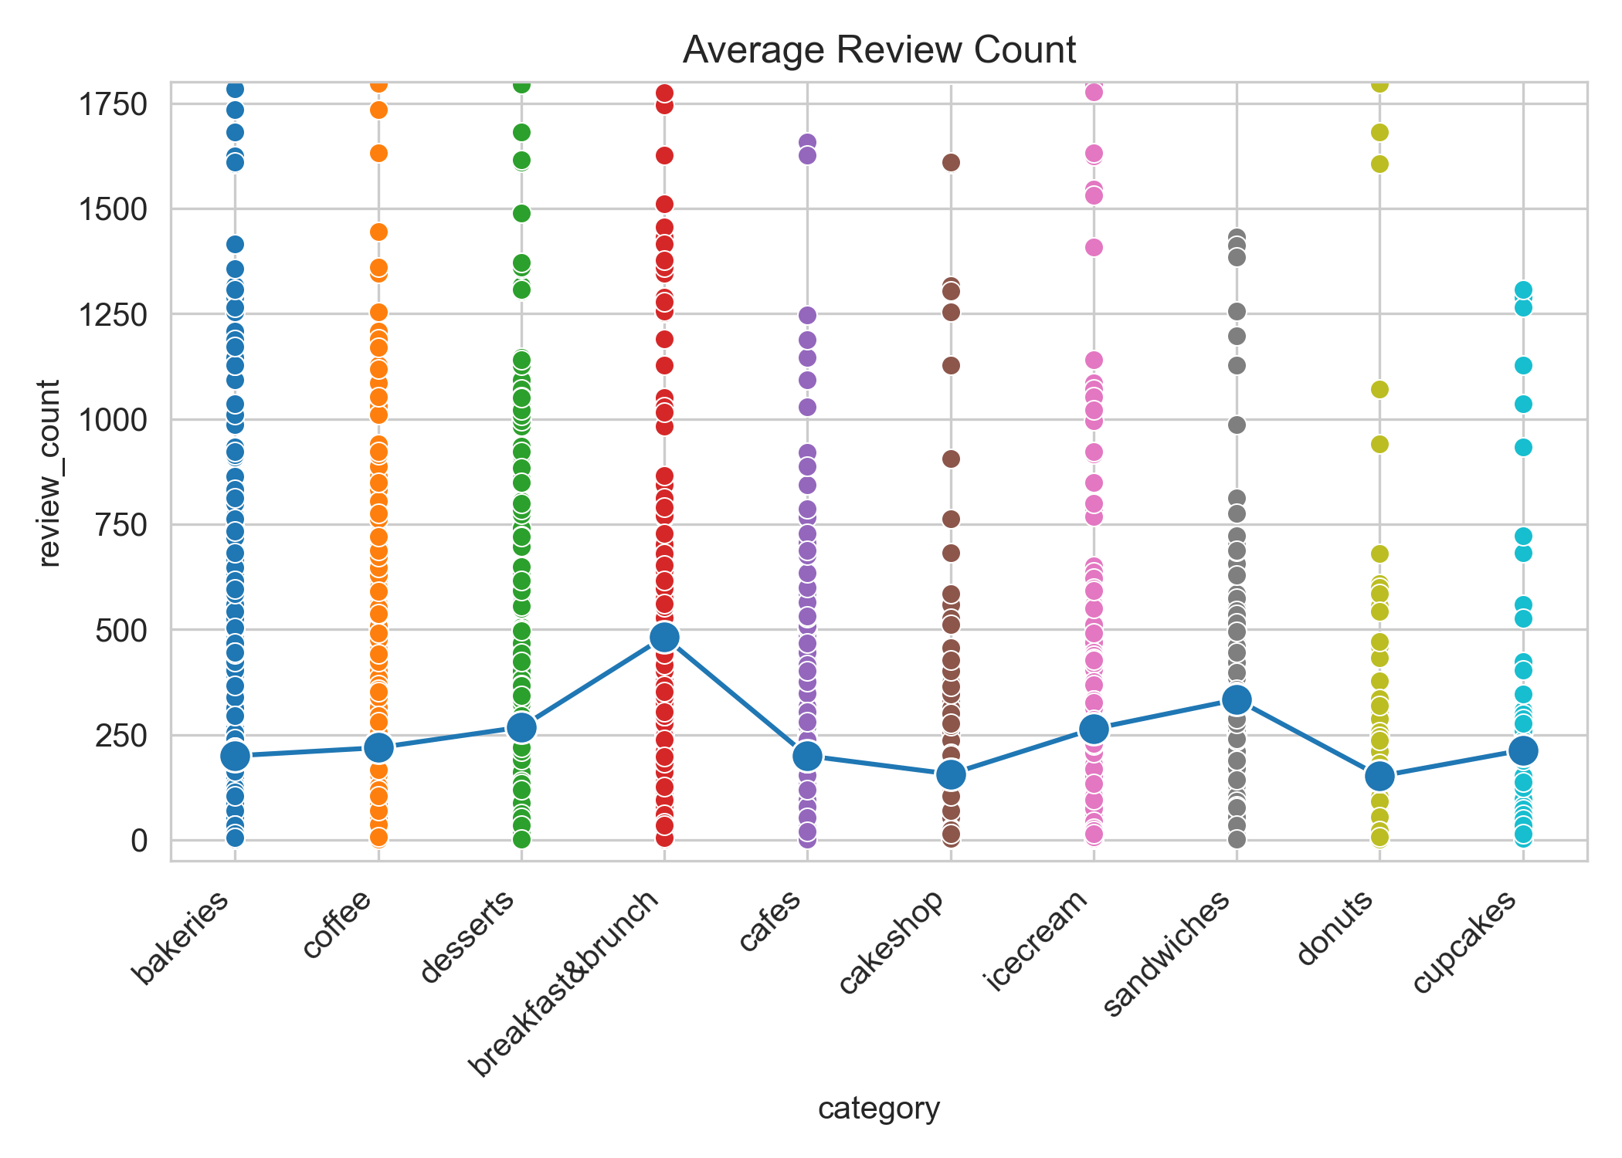
Review Counts by Category, Visualized
Using Review Counts as a metric for foot traffic:
On average, breakfast&brunch have more foot traffic, along with sandwiches
‘Desserts’ on average, has more foot traffic compared to other dessert categories

Slide 11
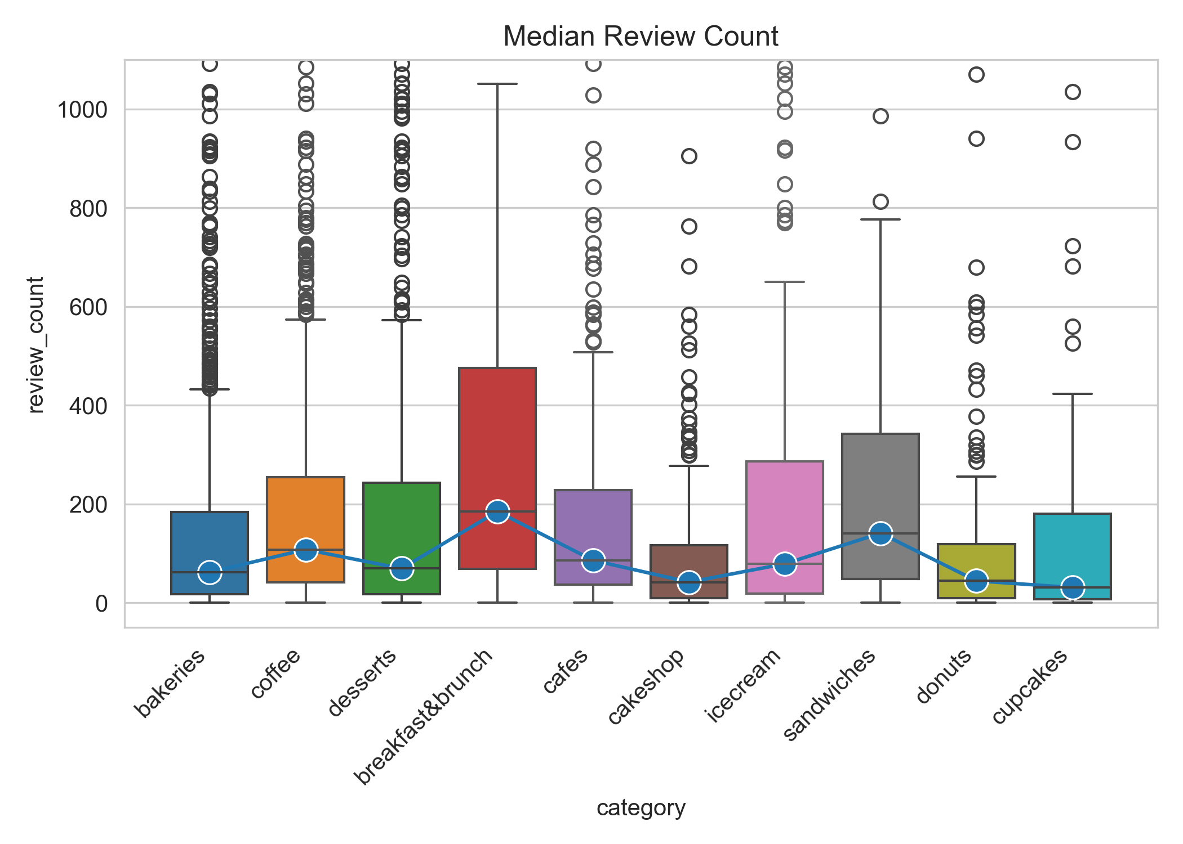
Review Counts by Category, Visualized
Using Review Counts as a metric for foot traffic, when looking at median values:
BnB and sandwiches still perform better
Coffee shops and cafes has higher foot traffic.

Slide 12
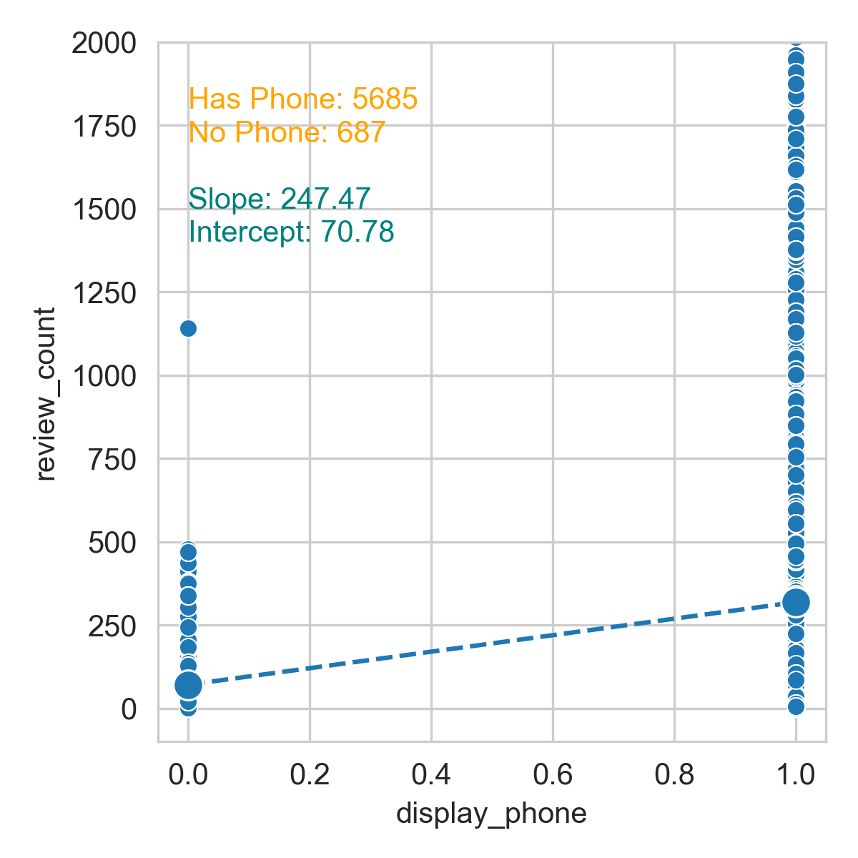
Phone numbers and Impact on Business
Having a phone number seems to have an impact on business performance.
Having a phone number increases the review_count of a business by about 250 reviews.

Slide 13
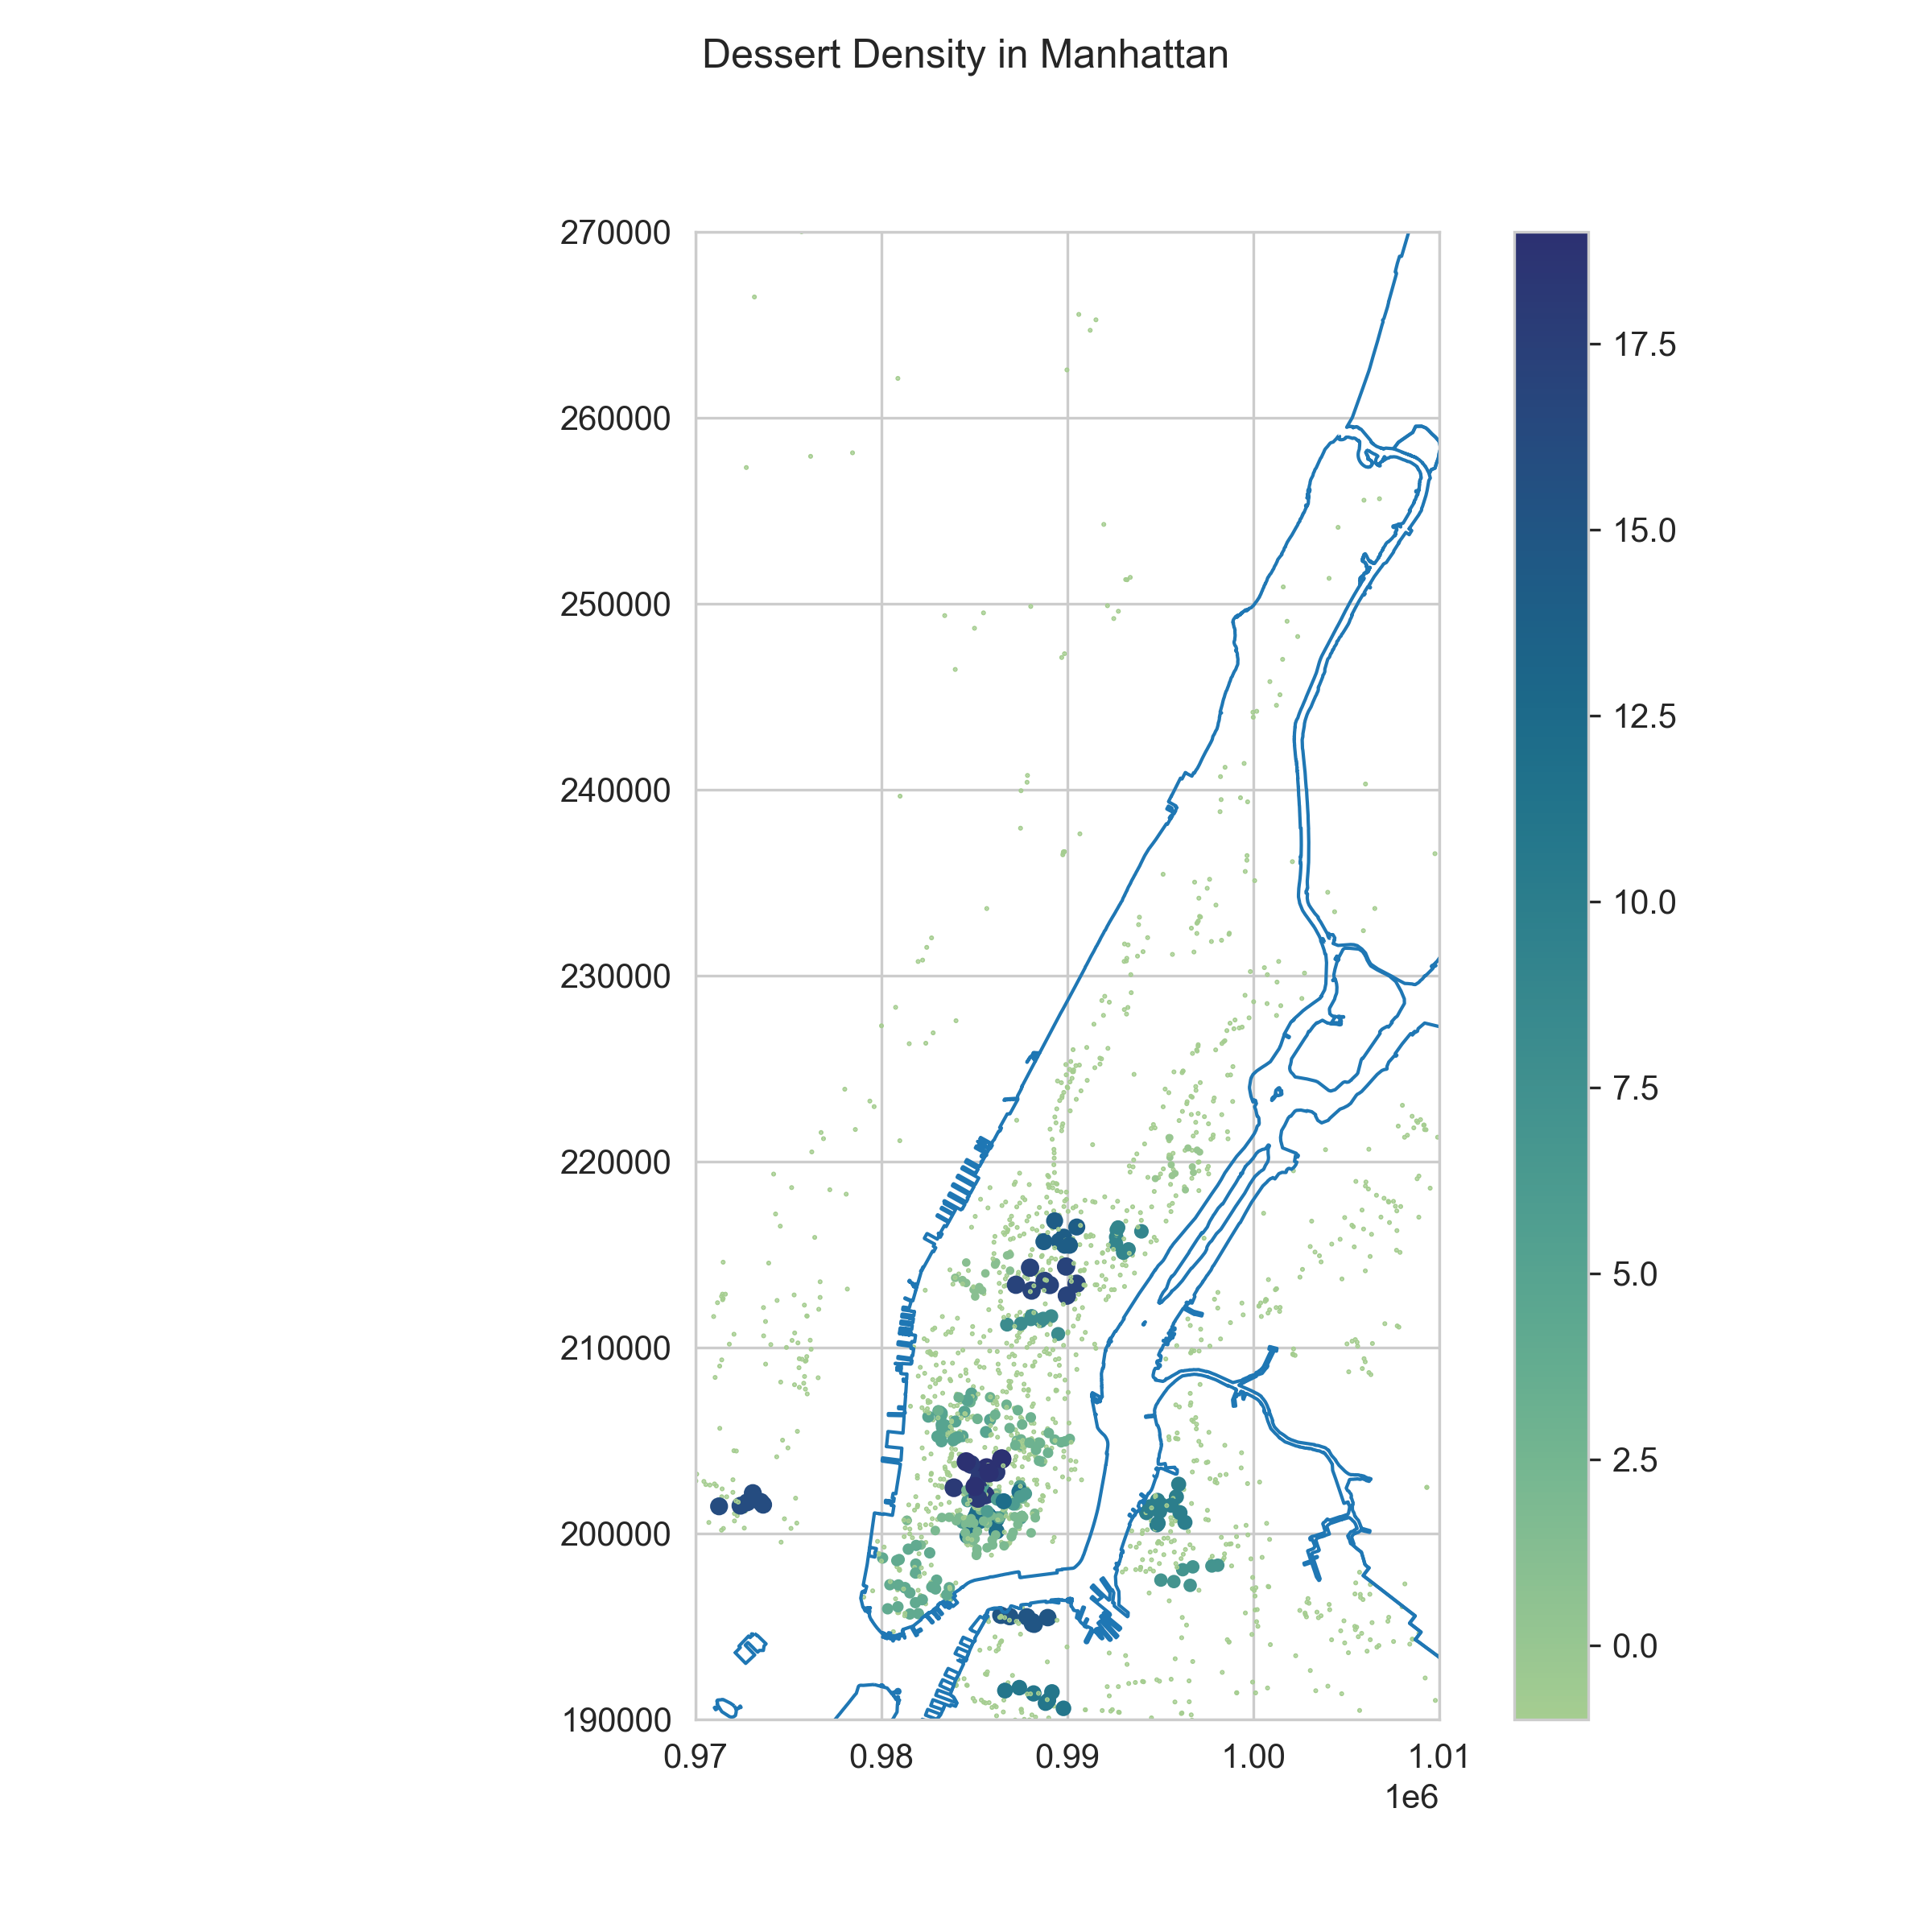
Spatial Clustering Analysis (Manhattan) Density-Based Spatial Clustering of Applications with Noise (DBSCAN) with review_count
Again, using review_count as a metric for foot traffic, performed spatial clustering to determine what areas have the highest foot traffic and thus have the greatest opportunity for success

Slide 14
Spatial Clustering Analysis (Manhattan) Density-Based Spatial Clustering of Applications with Noise (DBSCAN) with review_count
Candidate Neighborhoods
Mid-town
Union Square
Chelsea
SoHo
Nolita
Chinatown
Mid-town East
Financial District
ε = 0.025, min_samp = 7

Slide 15
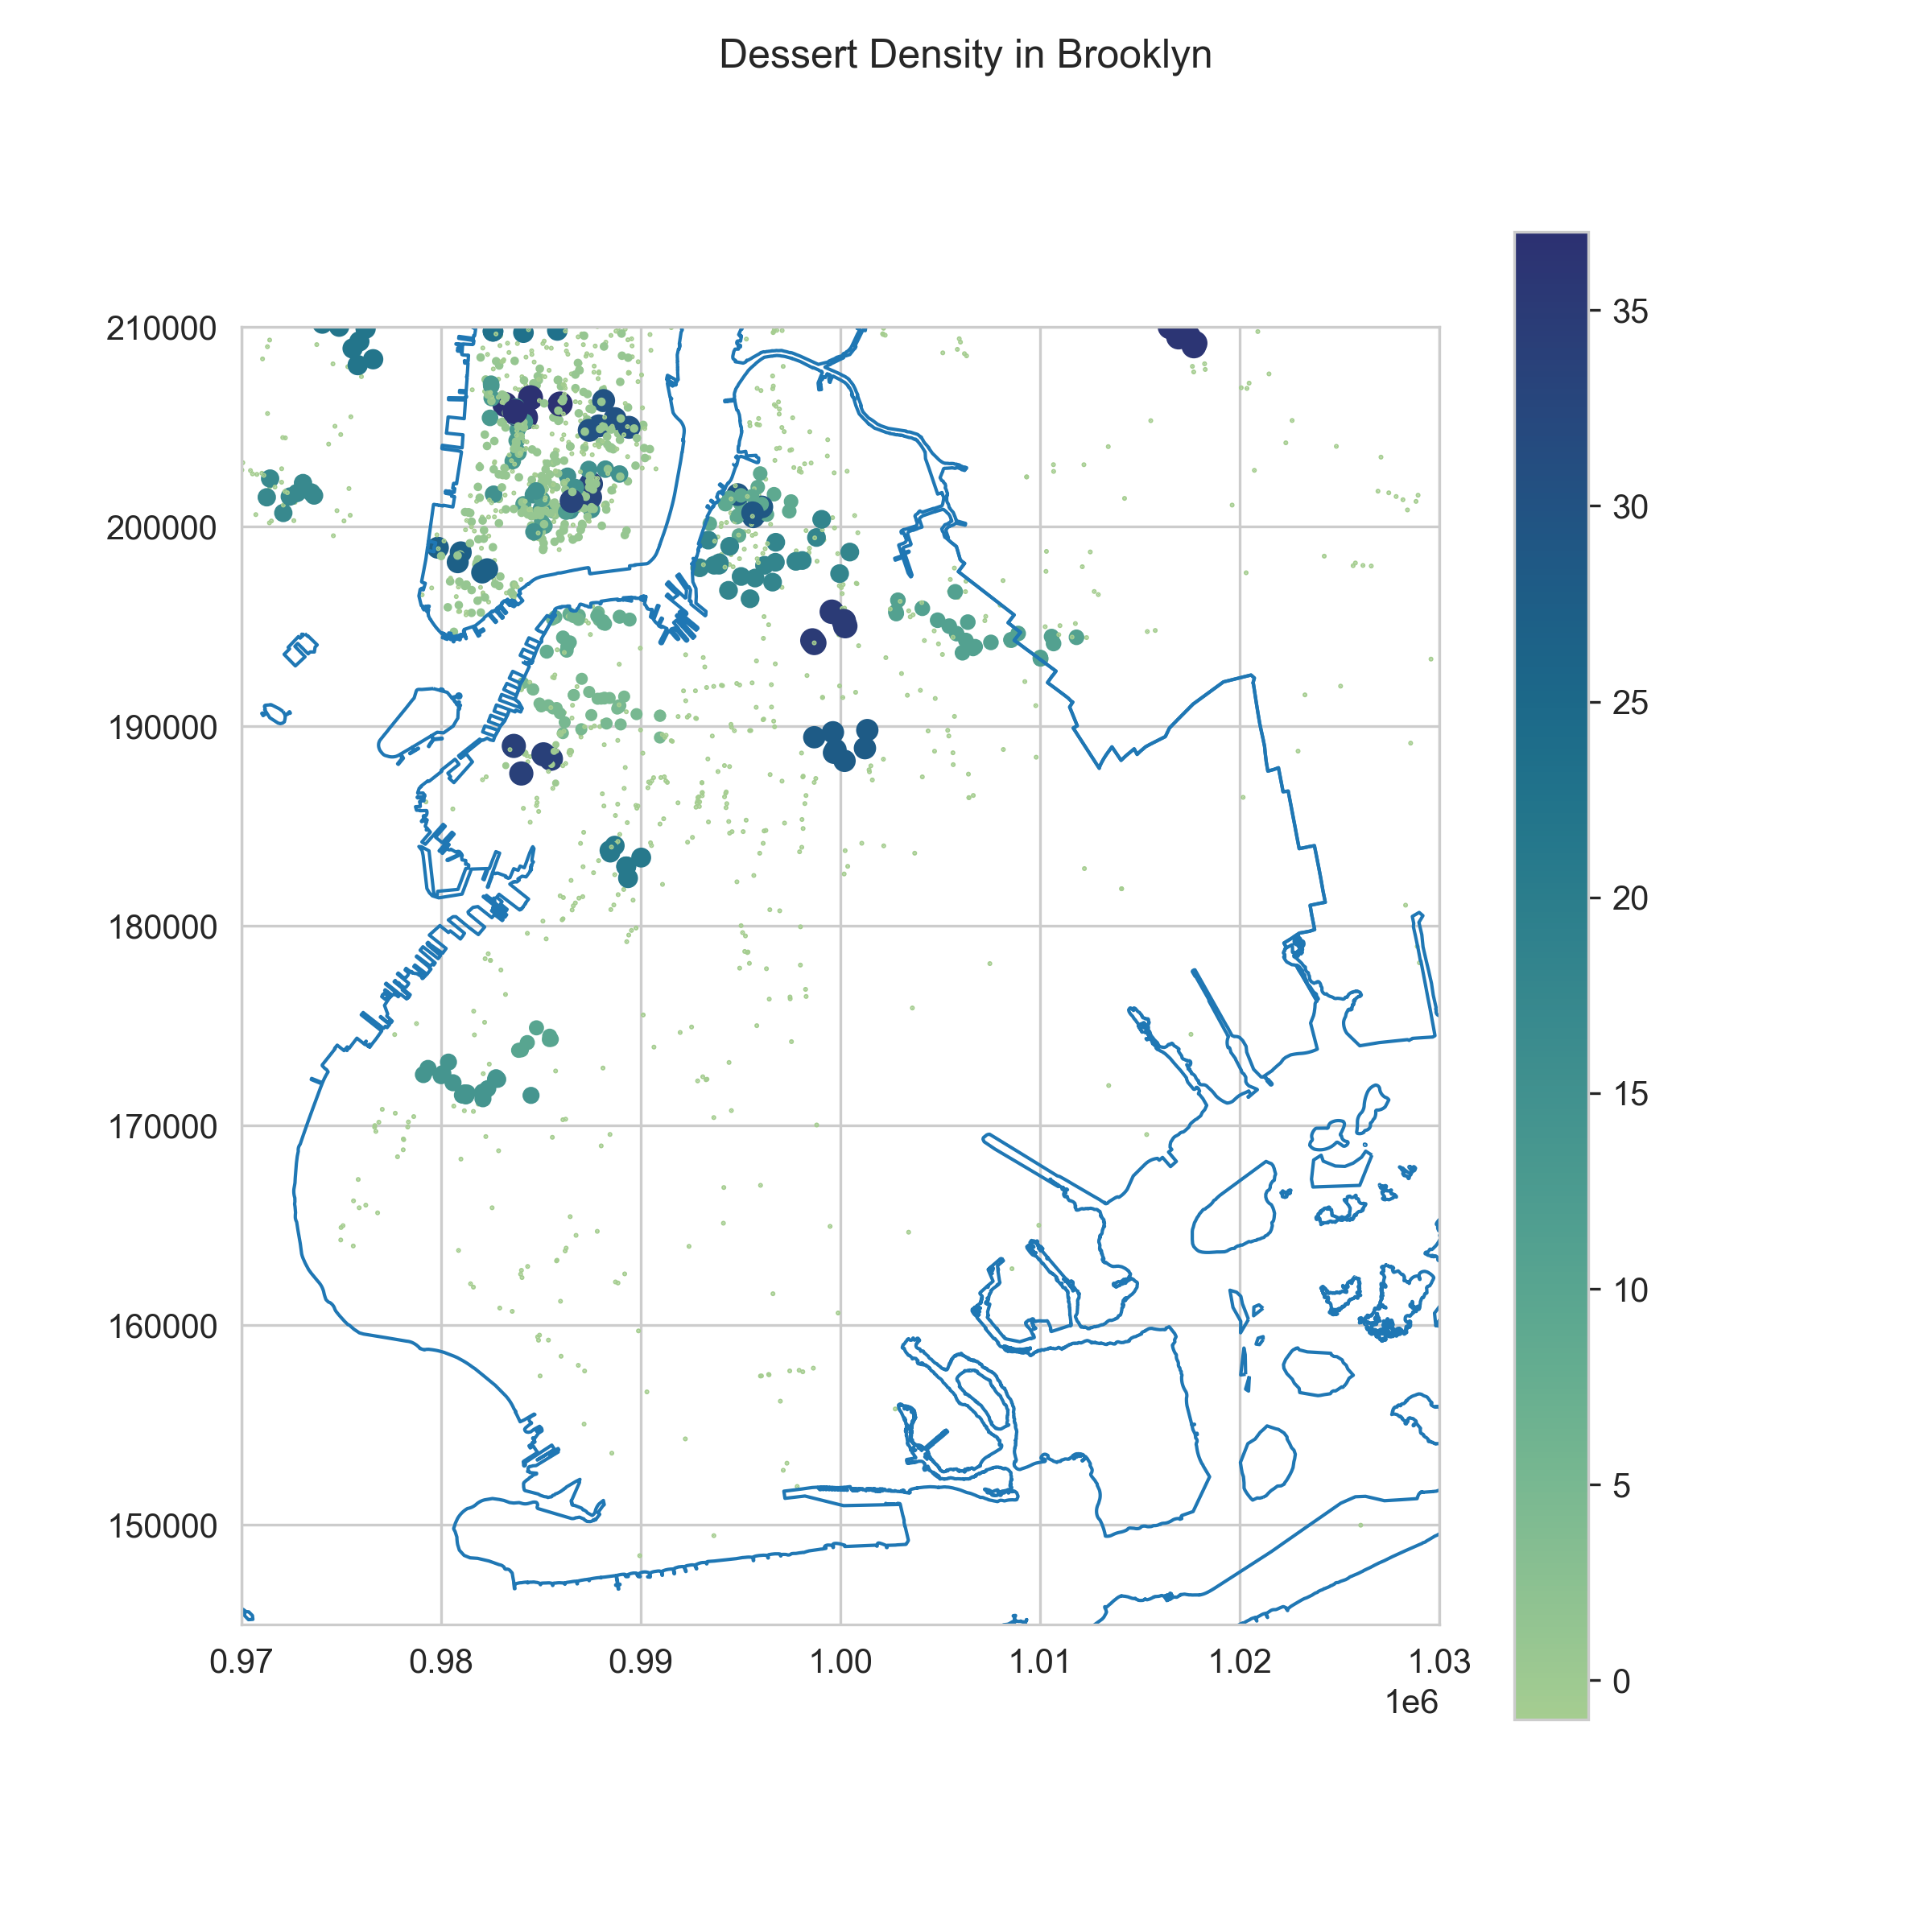
Spatial Clustering Analysis (Brooklyn) Density-Based Spatial Clustering of Applications with Noise (DBSCAN) with review_count
Candidate Neighborhoods:
Bed-Stuy
Bushwick
Redhook
Williamsburg
Park Slope
Sunset Park
ε = 0.03, min_samp = 5

Slide 16
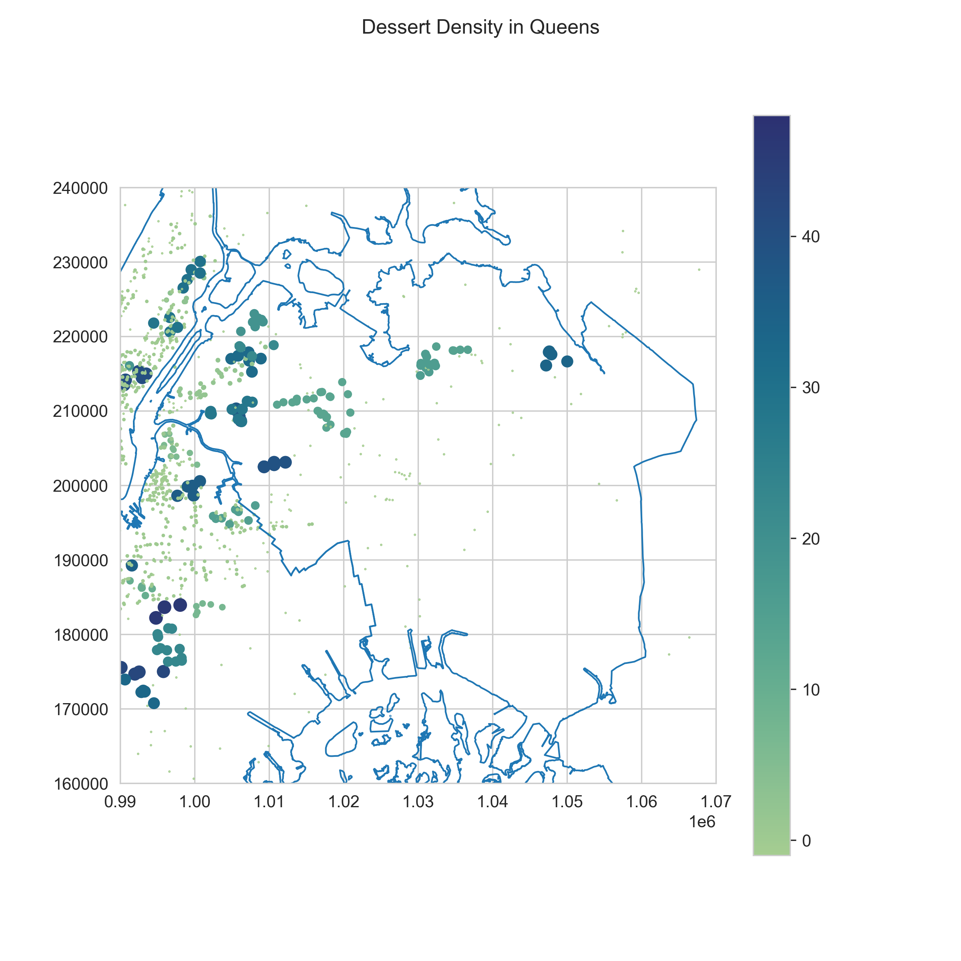
Spatial Clustering Analysis (Queens) Density-Based Spatial Clustering of Applications with Noise (DBSCAN) with review_count
Candidate Neighborhoods
Ridgewood
Bayside
Astoria
Sunnyside
Flushing
Woodside
ε = 0.05, min_samp = 4

Slide 17
Conclusions
Dessert-focused businesses in NYC face many challenges but given the right business model and location, can see success.
Bakeries comprise about 26% of dessert cohorts.
Cupcakes, cakeshops, ie ‘single specialty’ shops are not as popular and do not see high foot traffic.

Slide 18
Conclusions
Coffee and drinks may be an entry point for many new customers since we see the higher review_counts in these categories.
Given the popularity of non-dessert categories, savory menu items may entice customers.
Based on the clustering model used, certain locations see much higher foot traffic compared to others.

Slide 19
Limitations
Does not account for population density of local neighborhoods.
Does not account for the age of the business.
Does not account for social media presence. With emergence of reels and tiktok, some social media presence can have a significant impact on foot traffic.
Foodie culture: We cannot account for social media influences on a business’ reviews and review_counts

Slide 20
Methods
Summary statistics
Data aggregation
Regression analysis
ANOVA and Tukey’s Honestly Significant Difference
Density Based Spatial Clustering of Applications and Noise for Spatial Analysis

